Slide 1





Churn prediction in an Internet Service Provider
Supervised By
Mr. Ayoub KETATA
Mr. Riadh KSANTINI
Realized by
Ahmed MANSOURI
Academic year
2017 / 2018
Notes:
Good afternoon everybody, my name is Ahmed MANSOURI and I am so delighted to be here today to talk to you about my graduation project which is titled “Churn prediction in an Internet Service Provider” , I was supervised by
At the beginning I’d like to take this opportunity to thank all the people who supported and guided me during the last six months. Similarly, I’d like to thank the jury’s effort to evaluate my work.

Slide 2
Outline
Presentation Overview
1
General Introduction
4
Models Design
2
Problematic & Motivation
5
Dashboard development
3
Project Solution
6
General Conclusion
1
Notes:
Shall we begin with the presentation outlines. . My talk is divided into 6 parts , first I will start by a general introduction where the context of the project is presented, second we move to the problematic and the motivation behind this work, the proposed solution and the models design will go in third and the fourth parts then we will discuss the dashboard development and we will finish by a general conclusion
=======================================

Slide 3
Outline
Presentation Overview
1
General Introduction
4
Models Design
2
Problematic & Motivation
5
Dashboard development
3
Project Solution
6
General Conclusion
2

Slide 4
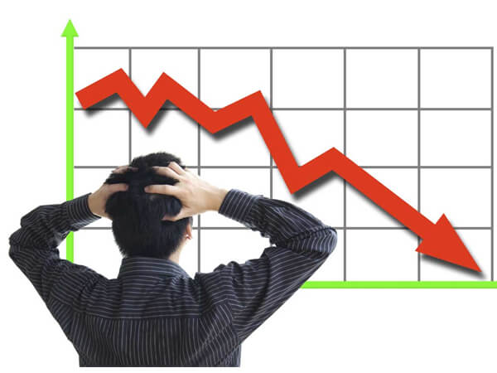


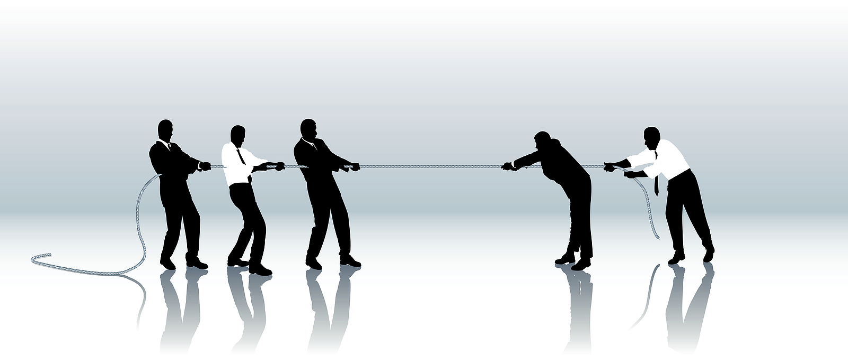

General introduction (1/3)
ISPs are facing a loss of revenue
Competition
Loss of potential customers
3
Notes:
Today, Internet Service Providers, including GlobalNet the subsidiary of 3S, are subject of a revenue loss due to the competition in this field and the loss of potential customers,

Slide 5
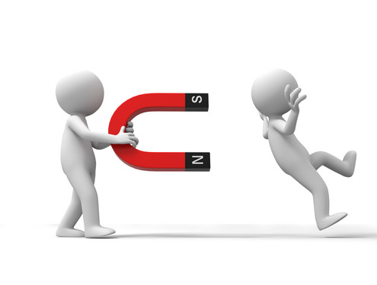
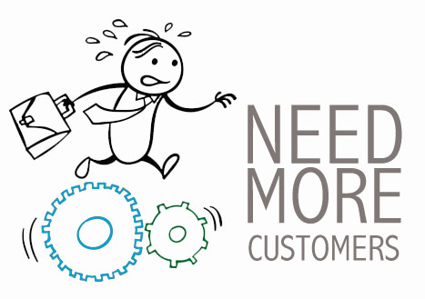
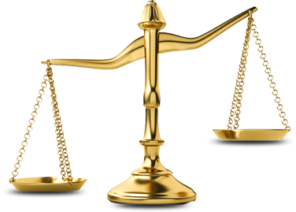

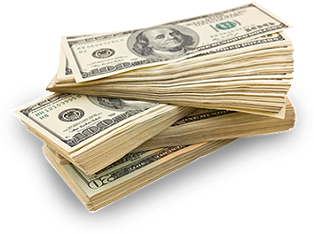



General introduction (2/3)
Obtain new customers
Retain existing customers
(5-10) x
Advertising
( Junxiang Lu, California university )
Customer churn:
A subscription that is stopped by a current customer is called a customer churn.
Television
Sales promotion
News-
papers
customer retention has become even more important than customer acquisition.
Radio
Social
media
4
Notes:
To deal with this problems and acquire as many customers as possible, most Internet service providers invest a huge amount of revenue to obtain new customers using different types of advertising like advertising in Television , in radio , in ,,,,,,, , also the sales promotion ,
However, many researchers , like the Junxiang Lu from California university, announce that it costs 5-10 times more to obtain a new customer than to retain an existing one and don’t let him churn
By the way : Customer churn is when an existing customer stops doing business or ends the relationship with a company.
So, we can see from this comparison that customer retention has now become even more important than customer acquisition.

Slide 6



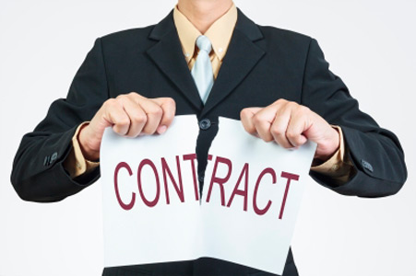
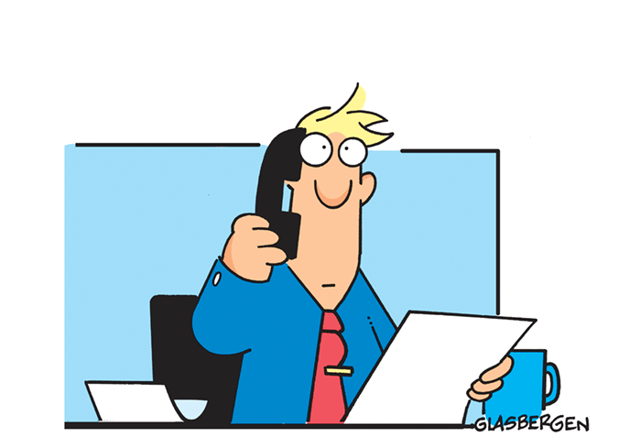

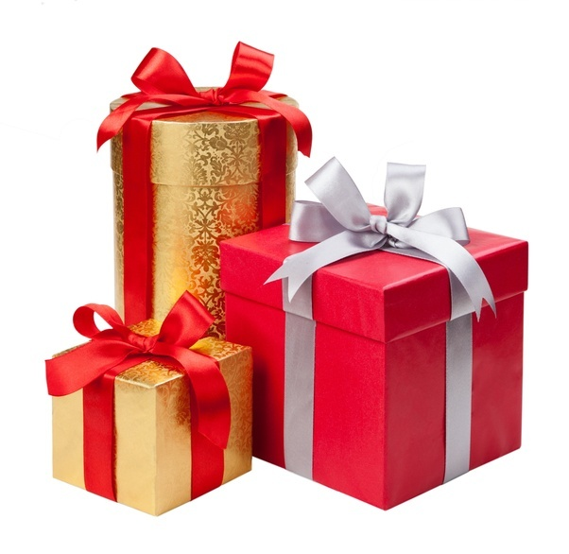
General introduction (3/3)
Retain existing customers
Day of churn
Proactive approach
Reactive approach
When the customer asks to cease his contract
Customer satisfaction survey
Identify problems
offer some advantages and incentives
5
Notes:
there are two approaches followed by an Internet service pro to retain existing customers:
+ ) the first is proactive approach: here the ISP do a customer satisfaction survey to identify which customers are more likely to churn, and it offer them some advantages and incentives in order to retain them,
+ )the second is the reactive approach, here the company waits until the customer asks to stop his contract to act,

Slide 7
Outline
Presentation Overview
1
General Introduction
4
Models Design
2
Problematic & Motivation
5
Dashboard development
3
Project Solution
6
General Conclusion
6

Slide 8



Problematic & Motivation
The ISP can’t individualize customer retention
Who will accept to stay with the company?
great number of customers
The ISP can’t predict all customers that will churn.
The ISP can’t predict all customers that will be recovering.
Machine learning + Data Mining
Customer churn
prediction
Customer’s recovery
prediction
7
Notes:
The problem here is that the Internet Service Provider can’t contact all his customers because of their large number, therefore the company will identify only a few number of customers that will churn,
The second problem is, we suppose that the ISP succeeded to predict who will churn , now it will contact them to give them advantages and incentives , but it is not sure that these customers will accept to stay will the company, therefore it will be a loss of time and money,
To deal with these problems, 3S wants to use Machine learning tools and Data Mining methods to solve these two issues in two tasks :
Customer churn prediction and Customer’s recovery prediction .

Slide 9
Outline
Presentation Overview
1
General Introduction
4
Models Design
2
Problematic & Motivation
5
Dashboard development
3
Project Solution
6
General Conclusion
8

Slide 10
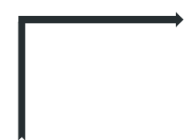
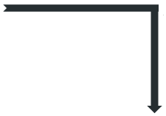



Project solution
Customer churn prediction
Preprocessing
Customer’s recovery prediction
Dashboard
Loading Data
9
Notes:
The purpose of this project is to create two models that help GlobalNet to reduce the churn rate:
The first model will predict the customer churn,
The second model will predict the customer’s recovery,
And a dashboard is needed to facilitate the use of these two models and to visualize results
in a global way, the system works as follows: first we load the dataset of active customers that we seek to predict if they will stay will the Internet Service Provider or not through the dashboard, ones the data was loaded , it will be passed to an important phase which is the data preprocessing, we will detail it later, ones the preprocessing was done the new data will be passed to the first model to predict the probability of churn, the results will be displayed in the dashboard. Now we can pass these customers to the second model to predict the probability of the recovery and as in the first prediction the results will be displayed in the dashboard

Slide 11
Outline
Presentation Overview
1
General Introduction
4
Models Design
2
Problematic & Motivation
5
Dashboard development
3
Project Solution
6
General Conclusion
10

Slide 12
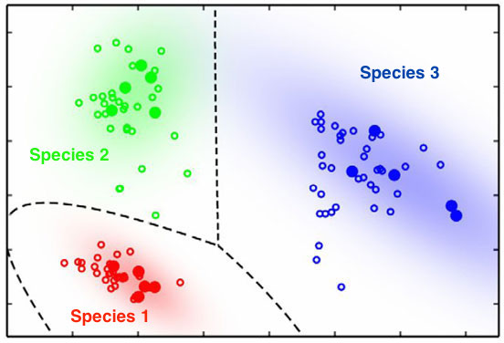
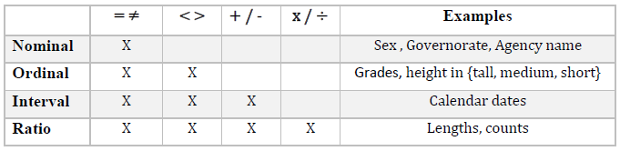
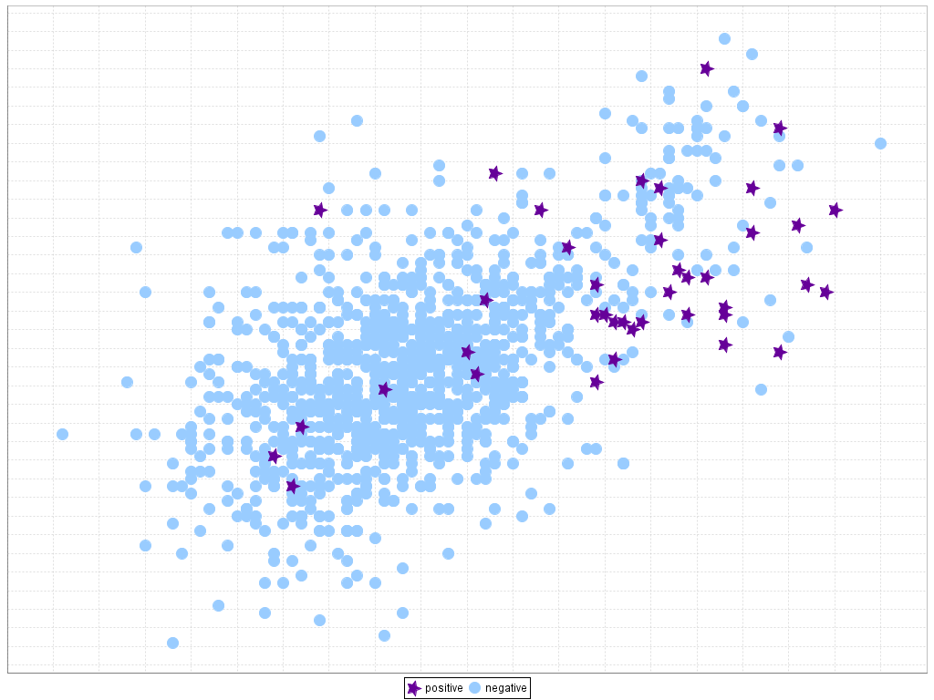


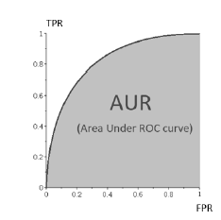
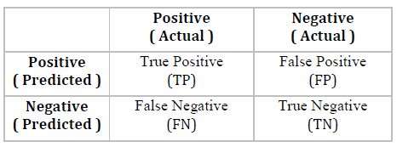
Models Design (1/9)
Review about machine learning
Classification
Attributes
Identifying to which classes or categories a new observation belongs.
Two types of classification:
Binary
Multi-target
Categorical
Quantitative
Categorical: descriptions of groups or things.
Quantitative: numerical variables.
Problem of imbalanced data
Performance measures
The classification categories are not equally represented.
Majority class : negative
Minority class : positive
The classifier ignore the positive class which is the class of our interest.
AUC
Confusion matrix
11
Notes:
Here we will give some notions related to machine learning:
Classification is the problem of identifying to which classes a new observation belongs, this is based on a training set of samples where the category of each observation is known from the start. “””The classification can be binary if we have only two classes or Multi-target where there are more than two classes,”””
Quantitative variables are numerical variables and Categorical variables are descriptions of groups or things
One major issue may occur during our models design which is the problem of imbalanced data,
Which occurs when dataset presents majority classes over minority ones, “””it appears generally in the case of binary classification”””, the minority class is called positive class and the majority is the negative one, This problem leads the classifier to ignore the positive class which is the class of our interest and to classify all samples as negative,
Now, to measure the performance of a classifier we need scores: we can use the accuracy score, the area under the roc curve score or f1 score, notes that here we chose to use F1 because accuracy and auc are can mislead the prediction in the case of imbalanced data problems, and finally we have the confusion matrix,

Slide 13



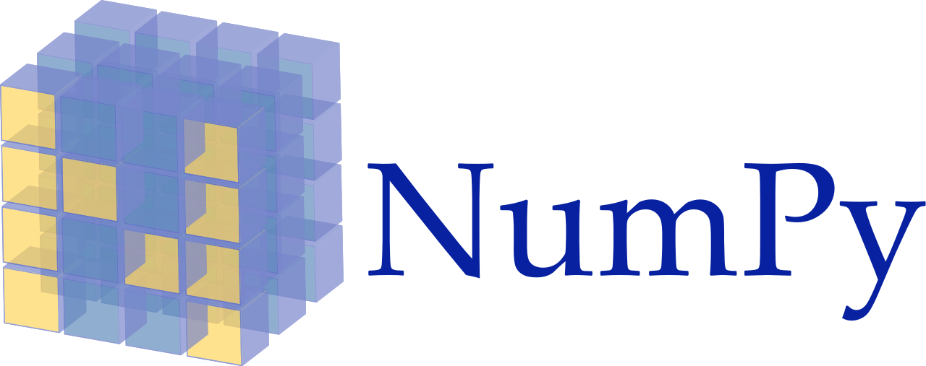





Models Design (2/9)
Programing languages & Libraries
12
Notes:
Before discussing the models design we start by presenting the used tools to implement those models: we have used python as programming language, numpy pandas, to manipulate data
orange and matplotlib for data visualization , and to create models we have used the machine learning libraries Sklearn , xgboost and lightGBM finally as IDE we have used Jupyter
Here is the list of technologies that we have used to create our models,

Slide 14
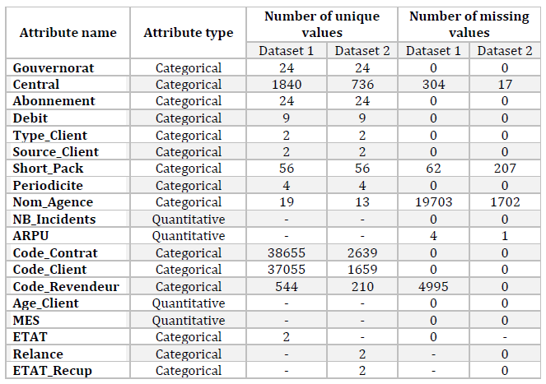
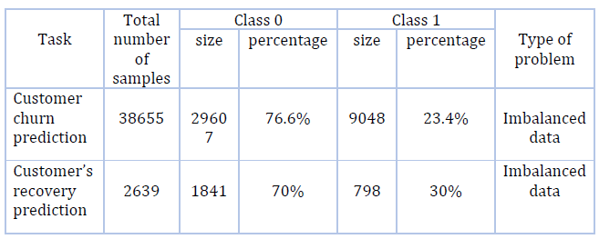
Models Design (3/9)
Datasets description
active
Successful recovery
Churn prediction
Recovery prediction
churned
failed recovery
Only two unique values for each classification
The majority of features are categorical
Binary classifications
Problem of the dominance of categorical
variables
The classes are not equally represented
Problem of imbalanced dataset
13
Notes:
For each one of the classification tasks we have a dataset used to train and test the models, Here is a description of them, for both datasets we have only two classes so can conclude that the two problems are binary classifications
We can also see that the size of the two classes in the datasets or not equal, for the fist one we have the class 0 which is the majority class has 77% of the samples and only 33% of samples in the class1 , and also the second dataset presents the same problems, so we can conclude that we have a problem of imbalanced data for the two tasks, also we can see that the majority of features are categorical so we can conclude that we have a problem of dominance of categorical variables,
each one of these datasets presents a target column with only two unique values so we conclude that the two classification problems are binary,

Slide 15
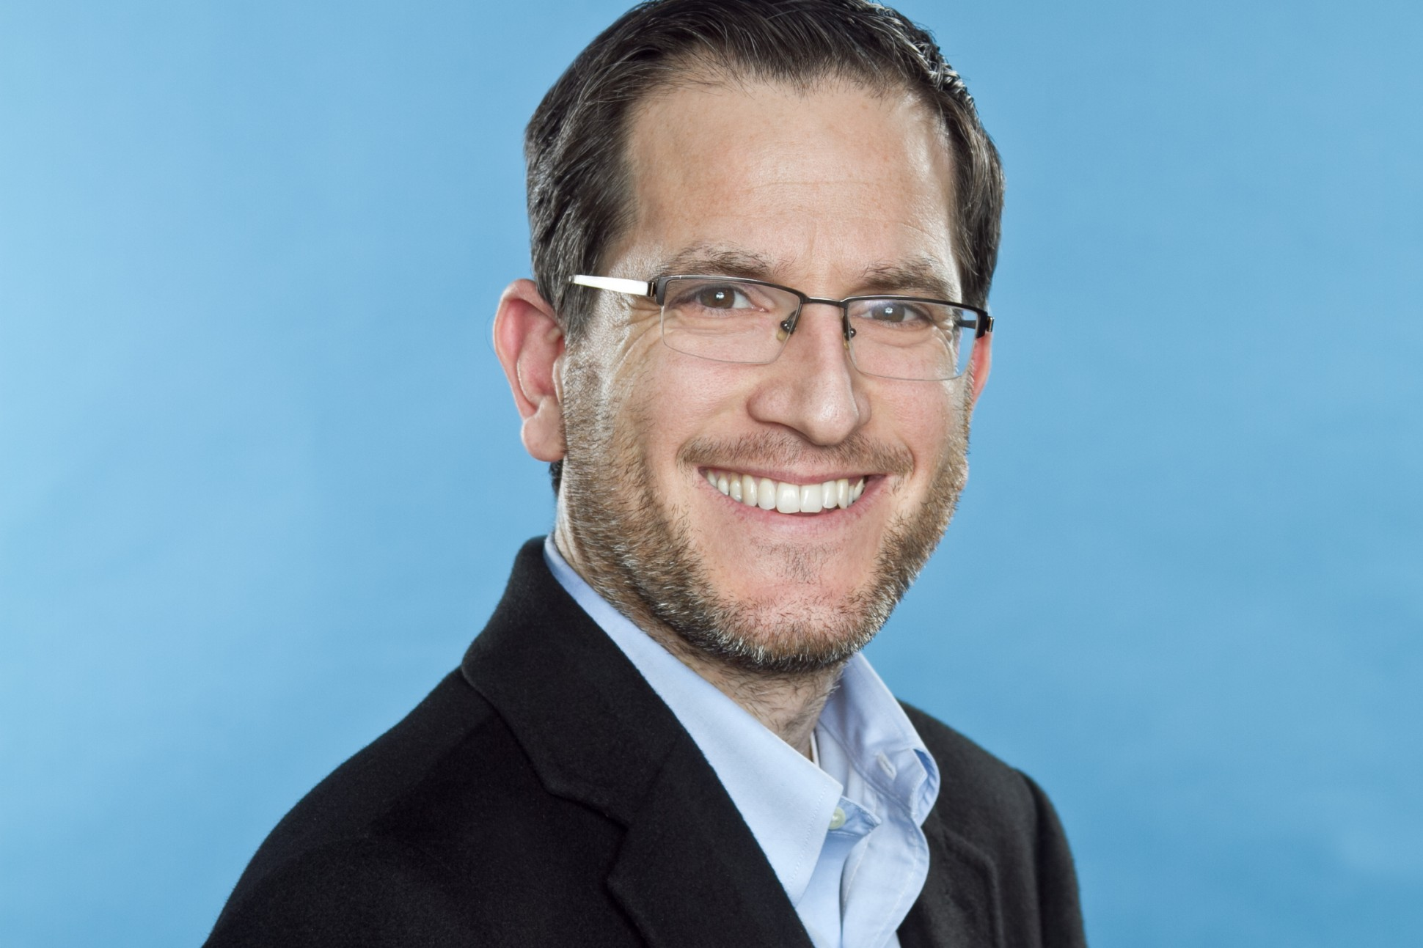
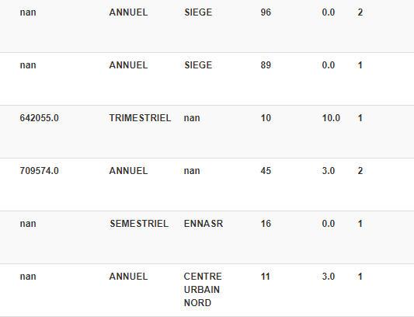
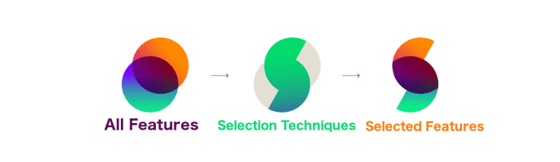
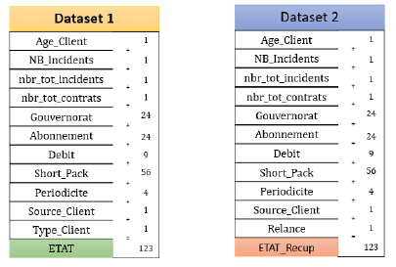
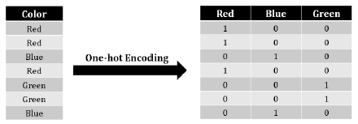
Models Design (4/9)
Preprocessing
Cleaning of missing data
Features selection
Gil Press
“Data scientists spend around 80% of their time on preparing and managing data for analysis”
Encoding data
Features extraction
Represent categorical data in a numerical format
Extract new features from the original features.
nbr_tot_contrats
nbr_tot_incidents
14
Notes:
Gil Press said “Data scientists spend around 80% of their time on preparing and managing data for analysis”, in our project we have spent lot of time in the preprocessing task, so let us highlight some of them,
The first technique used is the cleaning of missing data, as you see the datasets present many missing values that we have to clean it before any task, here the cleaning can be by removing or filling these missing data by the mean , the median or the mode of the feature,
The second technique is the features selection, here we select from the original features the most important ones and the rest of features will be removed,
the next one is the encoding data, this technique trys to find a solution to represent categorical data in a numerical format, because machine learning algorithms expect numerical input data
And finally the features extraction , here we create new features from the original one , we have created two features the first is the total number of contracts for each customer and the second is the total number of incidents for each customer
Here is the final list of features for each datasets where there are one hundred twenty three final features

Slide 16
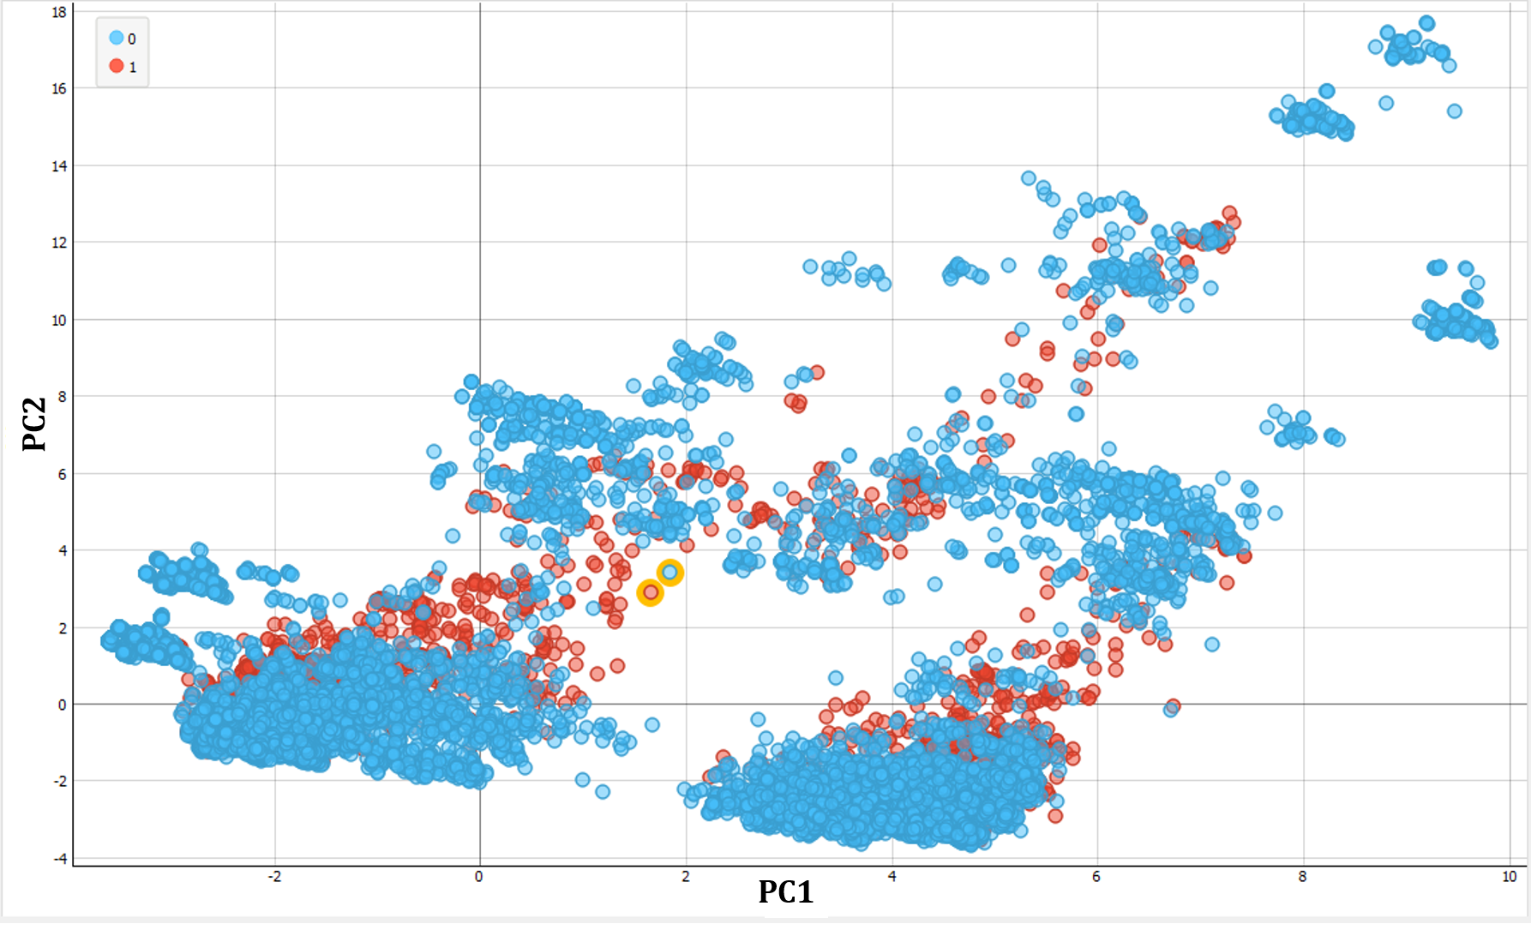
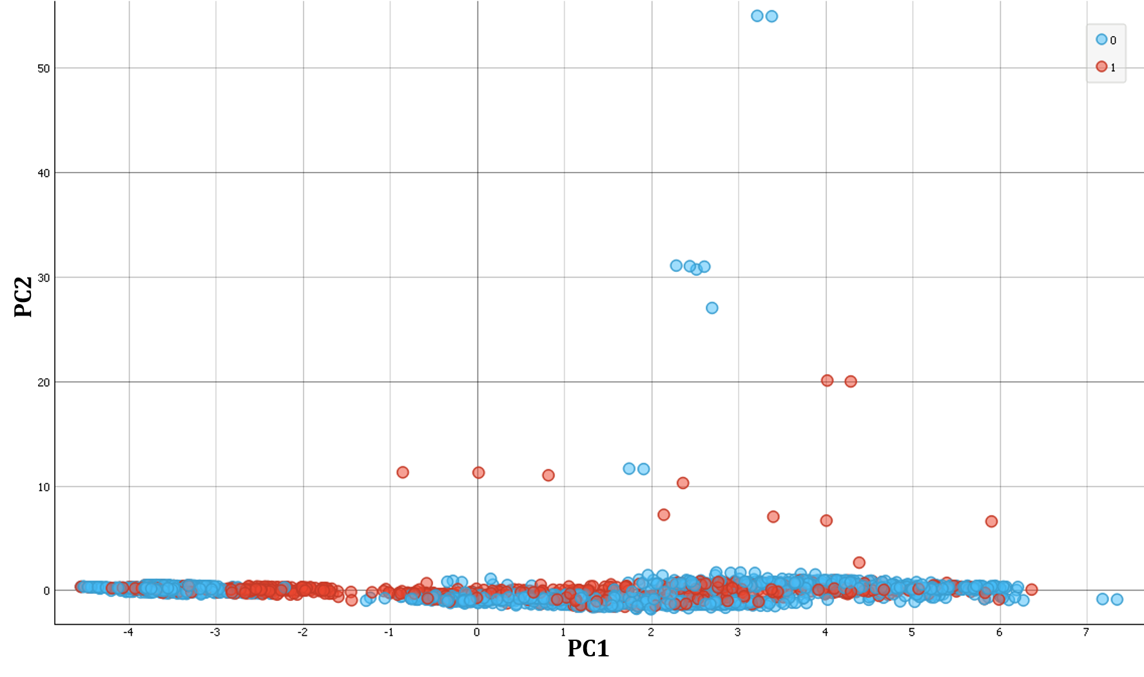
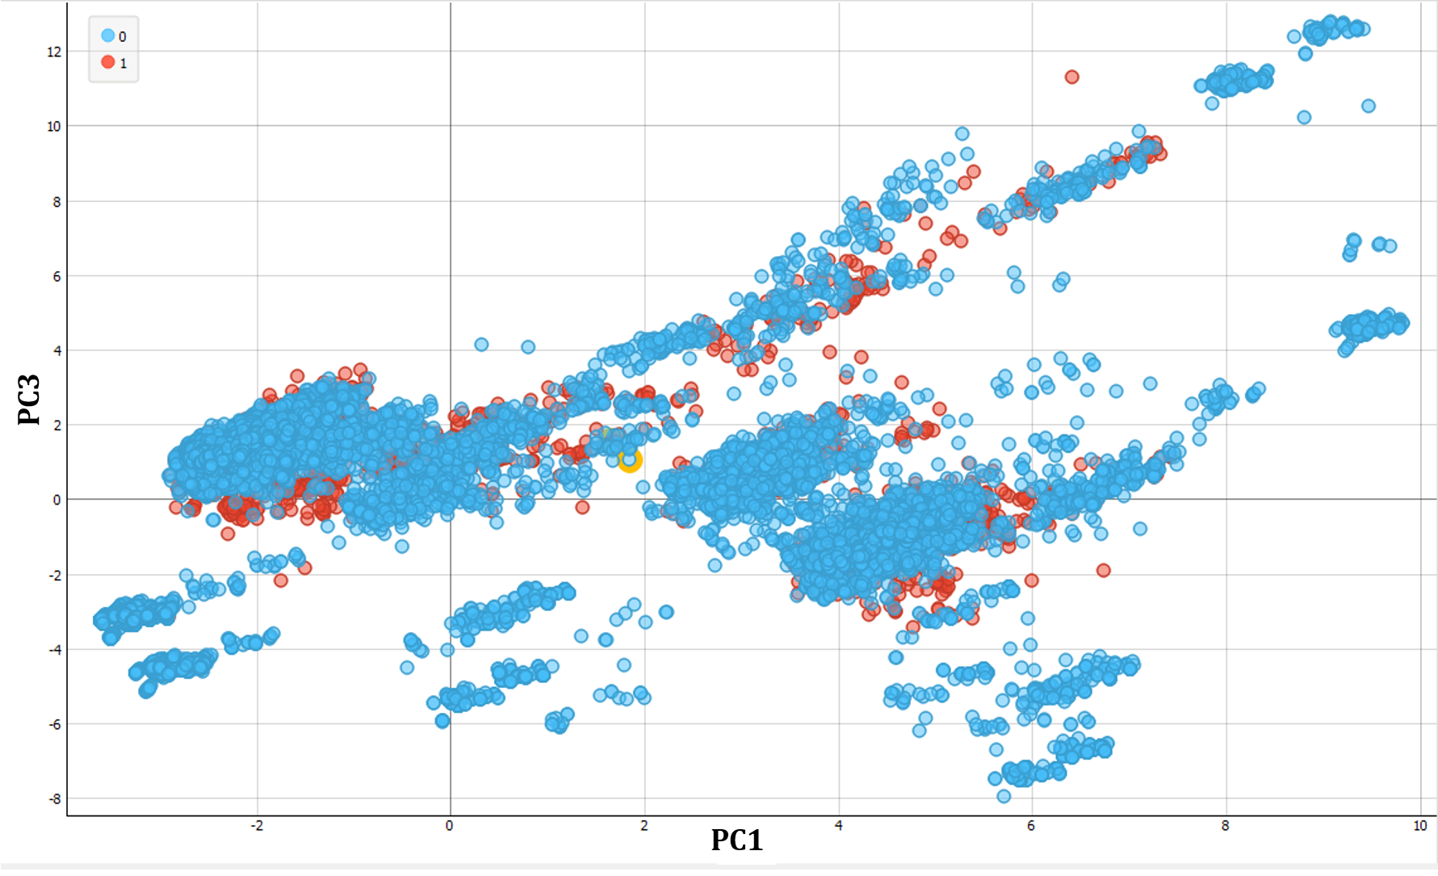
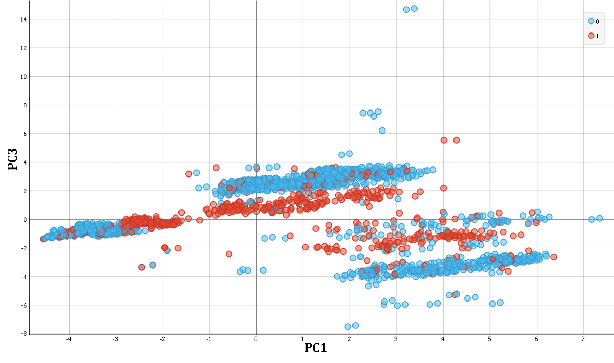
Models Design (5/9)
Data visualization
Data for churn prediction
Data for recovery prediction
The classes are overlapped
→ Non-linear problem
The classes are overlapped
→ Non-linear problem
15
Notes:
We move now to the data visualization, here we have used the PCA algorithm to reduce the dimentionaly of the space to visualize the distribution of the data in the space, we can see here for both datasets that the class in blue which the majority class overlap the minority class which is in red, and we can here that we cannot separate them by a linear method using linear or plan -- so we conclude that we have a non linear problem for the two classifications

Slide 17
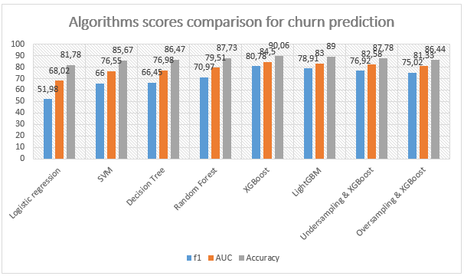
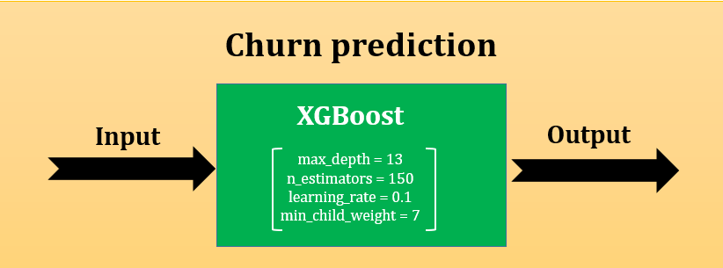
Models Design (6/9)
The choice of model for the churn prediction
→ The best F₁ score is equal to 80.78
16
Notes:
Now we pass to the choice of the model for the churn prediction, here we have done a comparison between several models ,,,,,,,,,,,,,,,,,,,,,,,,,,,,,,,,,,,,,,,,,,,,
in order to choose the best one for our problem, we have done the parameters tuning in order to get the best parameters in terms of score for each algorithm, then we compare the best scores to get the best model, XGBoost won the challenge with an F1 score equal to 80%

Slide 18
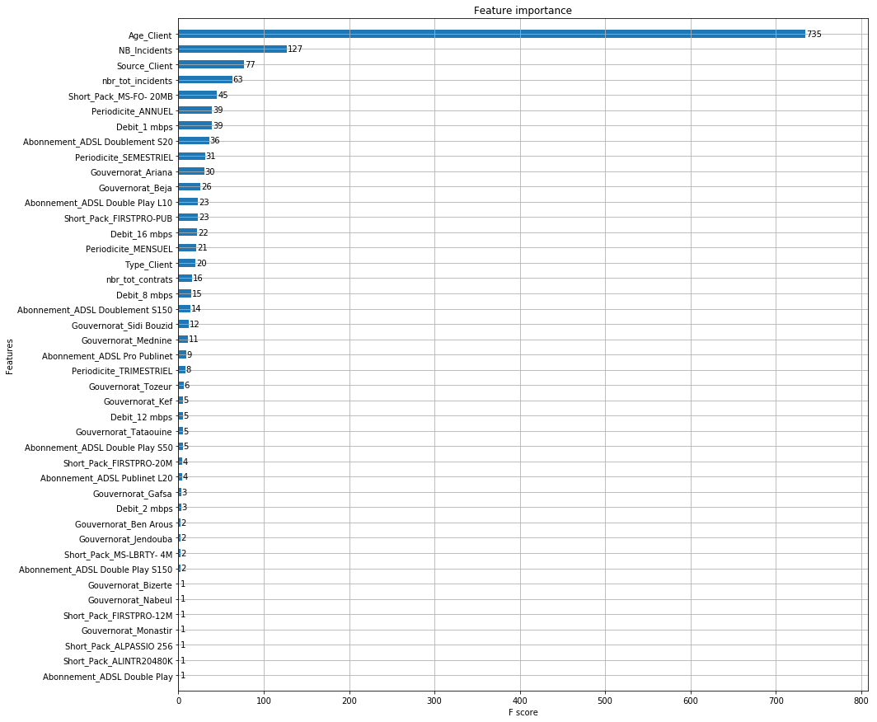
Models Design (7/9)
The choice of model for the churn prediction
Features importance according to XGBoost
17
Notes:
Here we show the features importance according to XGBoost, we can see that the customer age is the most important one, then the number of incidents,

Slide 19
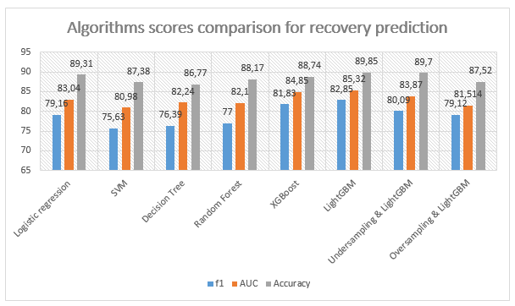
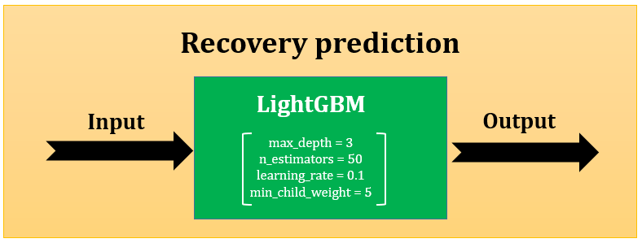
Models Design (8/9)
The choice of model for the recovery prediction
→ The best F₁ score is equal to 82.85
18
Notes:
Here we use the same logic as in the previous classification , only here we use undersampling + lighGBM and over +Ligh instead on XGBoost
Here also the other boosting algorithm won the challenge which is LightGBM

Slide 20
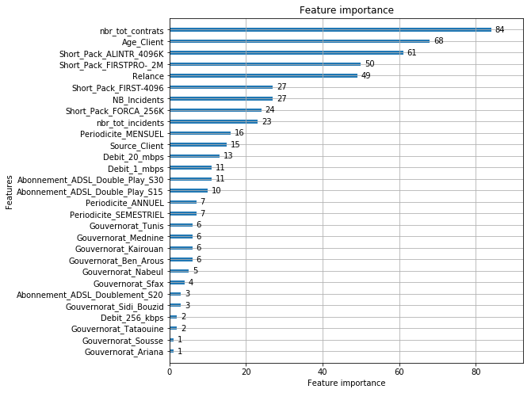
Models Design (9/9)
The choice of model for the recovery prediction
Features importance according to LightGBM
19
Notes:
Here the list of features importance according to LightGBM, the first one is the total number of contracts then the customer age and the “relance” feature which is the type of approach that the company has done comes in the fifth place

Slide 21
Outline
Presentation Overview
1
General Introduction
4
Models Design
2
Problematic & Motivation
5
Dashboard development
3
Project Solution
6
General Conclusion
20

Slide 22
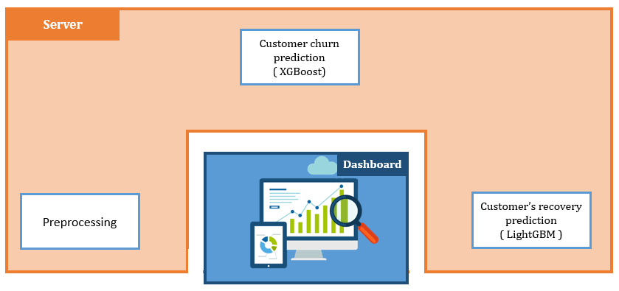
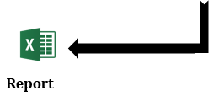
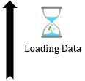

Dashboard development
Proactive & Reactive
4
4
6
7
3
3
2
8
2
5
1
1
21
Notes:
Now we return to the functionality of the system by more detail,
First of all, our platform is composed by a web server flask and the front end, initially the two models that we created and the preprocessing were stored in the server side, the user upload the data either by filling a form for one customer or by uploading an excel file for a group of customers, then the data will be passed to the preprocessing then to the churn prediction using the XGBoost model results are displayed in the dashboard, now the cycle for the prediction for one customer is ended and it rest the one for the group of customers, now we can pass to the recovery prediction, here the proactive and the reactive approach will be applied to get the best one for the prediction
and it ended by the display of results in the dashboard and the possibility of extracting a report,

Slide 23

22
Notes:
Now we move to the demo,

Slide 24
Outline
Presentation Overview
1
General Introduction
4
Models Design
2
Problematic & Motivation
5
Dashboard development
3
Project Solution
6
General Conclusion
23

Slide 25
General Conclusion
Conclusion
Perspective
Despite the complexity of this project, the goals were met by a successful design and implementation of machine learning models .
Many new skills both soft and technical kinds were acquired.
The performance of this project can be improved if the number of samples and features used to create models increases.
The type of the actions that the company do to retain the customers should be recorded for more precision.
24
Notes:
That brings us to the end of the presentation. I’d like to summarize by saying that
Despite the complexity of this project, The goals of th were met by successfully designing and implementing machine learning models to reduce the rate of churn in the Internet service Provider Globalnet
In terms of perspectives, The performance of this project can be improved if the number of samples and features used to create models increases.
and also The type of the actions that the company do to retain the customers should be recorded for more precision

Slide 26

THANK YOU FOR YOUR ATTENTION
Ahmed MANSOURI
25

